Slide 1
Data Stuctures and Algorithms
Dr. Fidaa Abed

Slide 2
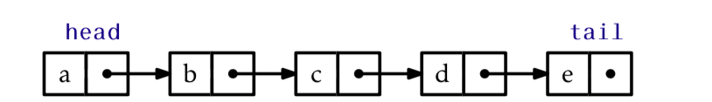
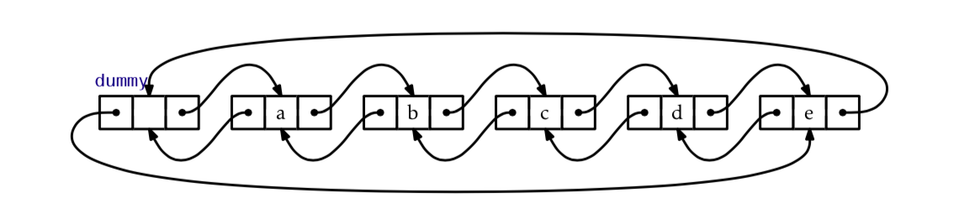
Doubly Linked Lists

Slide 3
Doubly Linked Lists
A dummy node is added to avoid special cases
No explicit Head
dummy.next is the head
No explicit Tail
dummy.previous is the tail

Slide 4
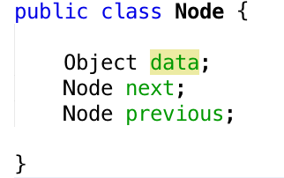
Doubly Linked Lists

Slide 5
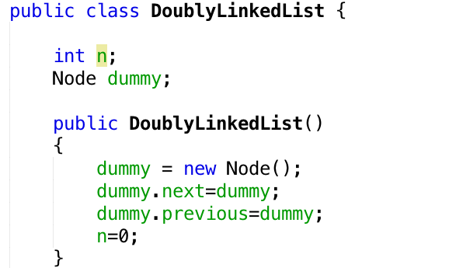
Doubly Linked Lists

Slide 6
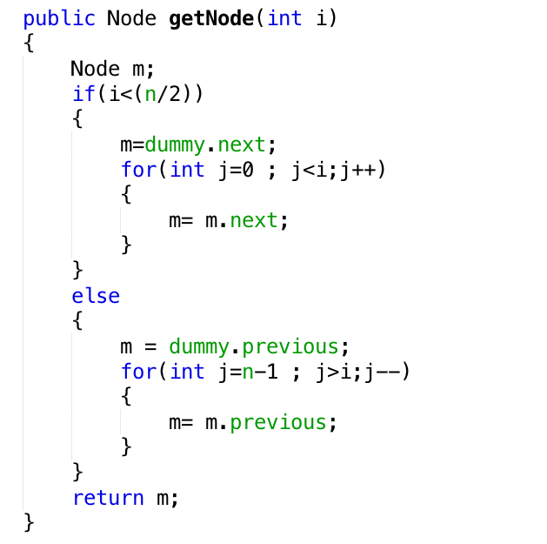
getNode(i)
O(min(i,n-i))

Slide 7
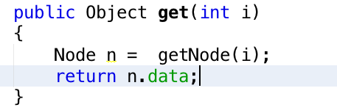
get(i)
O(min(i,n-i))

Slide 8
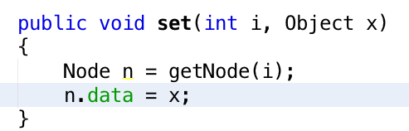
set(i, x)
O(min(i,n-i))

Slide 9
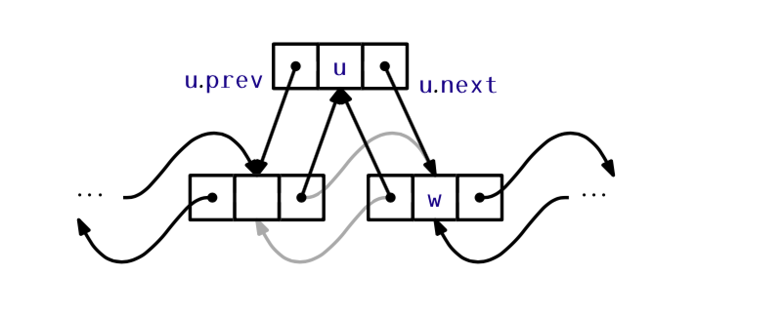
addBefore(w, x)

Slide 10
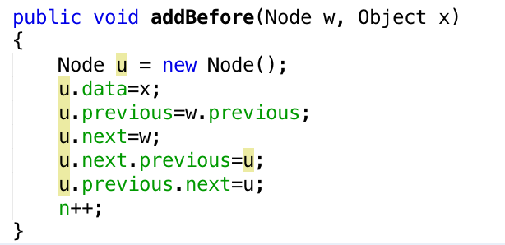
addBefore(w, x)
O(1)

Slide 11
addBefore(w, x)
O(1)

Slide 12
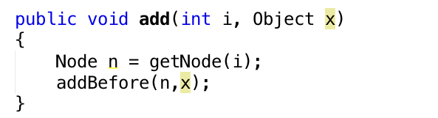
add (i, x)
O(min(i,n-i))

Slide 13
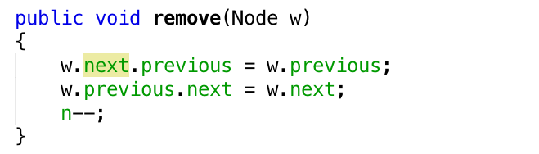
remove(w)
O(1)

Slide 14
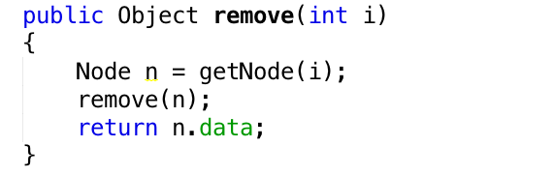
remove(i)
O(min(i,n-i))

Slide 15
Excercise
Implement Doubly linked list
Use the doubly linked lins as a Deque by implementing:
addFirst(Object x)
addLast(Object x)
removeFirst()
removeLast()

